Slide 1
DECISION SUPPORT SYSTEM FOR TELCO
Presented by
Chiliveru Revanth (189511)
Gunturu Sai KrishnaVarma (189875)
Bashupally Akhilesh (189507)
Akshat Kumar Gupta (189503)
Dasi Dinesh (189539)
Eppili Navya Sai (190220)
Yendluri Manogna (190135)

Slide 2
DECISION SUPPORT SYSTEM :
Decision Support systems is a computer- based information systems intended to help decision makers utilize data in order to identify problems.
DSS will help the service provider to analyze data in order to provide useful and explicit information.
DSS enables managers in the respective areas within the industry to fully utilize the vast amounts of data available to make projections and decisions in relation to utilization of valuable resources. order to provide useful and explicit information. DSS enables managers in the respective areas within the industry to fully utilize the vast tended to help decision makers utilize data in order to identify problems. DSS will help the service provider to analyze data in order to provide useful and explicit information. DSS enables managers in the respective areas within the industry to fully utilize the vast amounts of data available to make projections and decisions in relation to utilization of valuable resources.

Slide 3
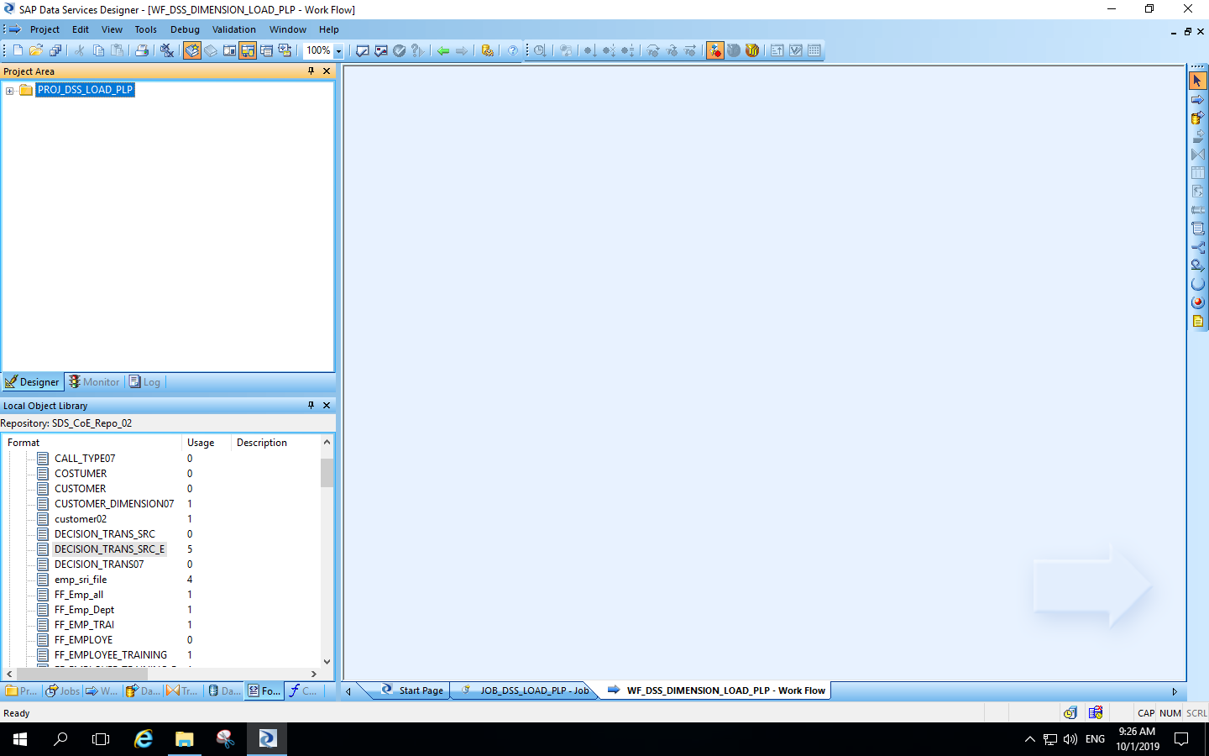
Creation of project :

Slide 4
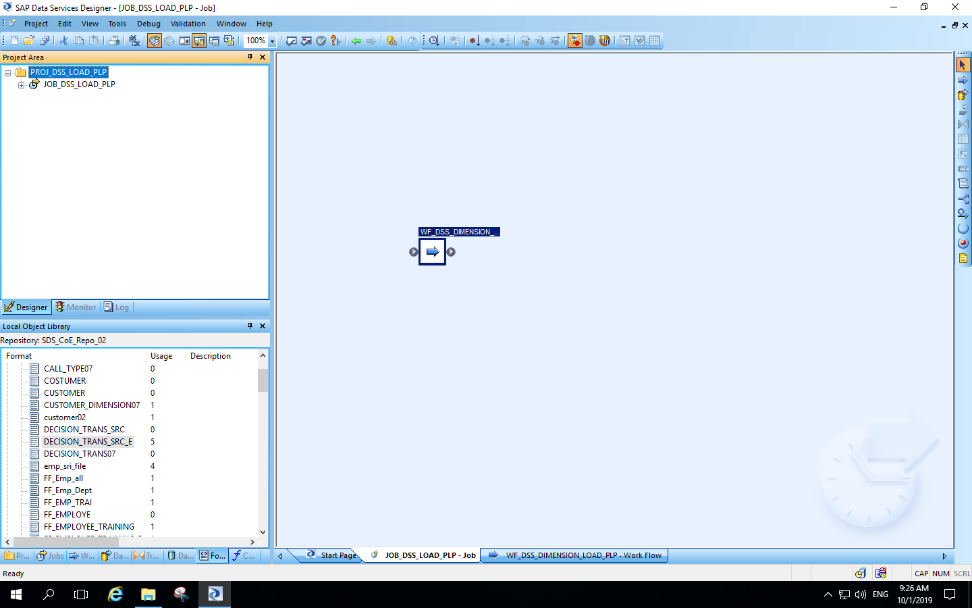
Creation of batch job and work flow :

Slide 5
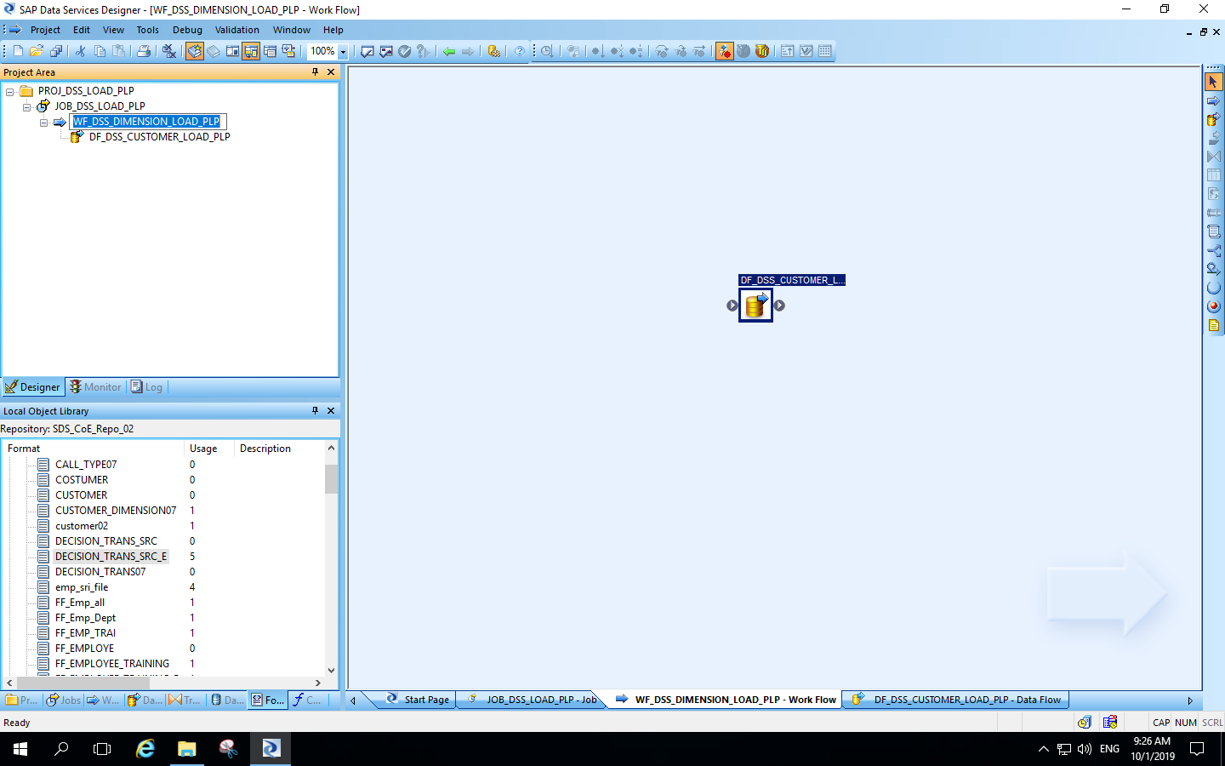
Creation of data flow :

Slide 6
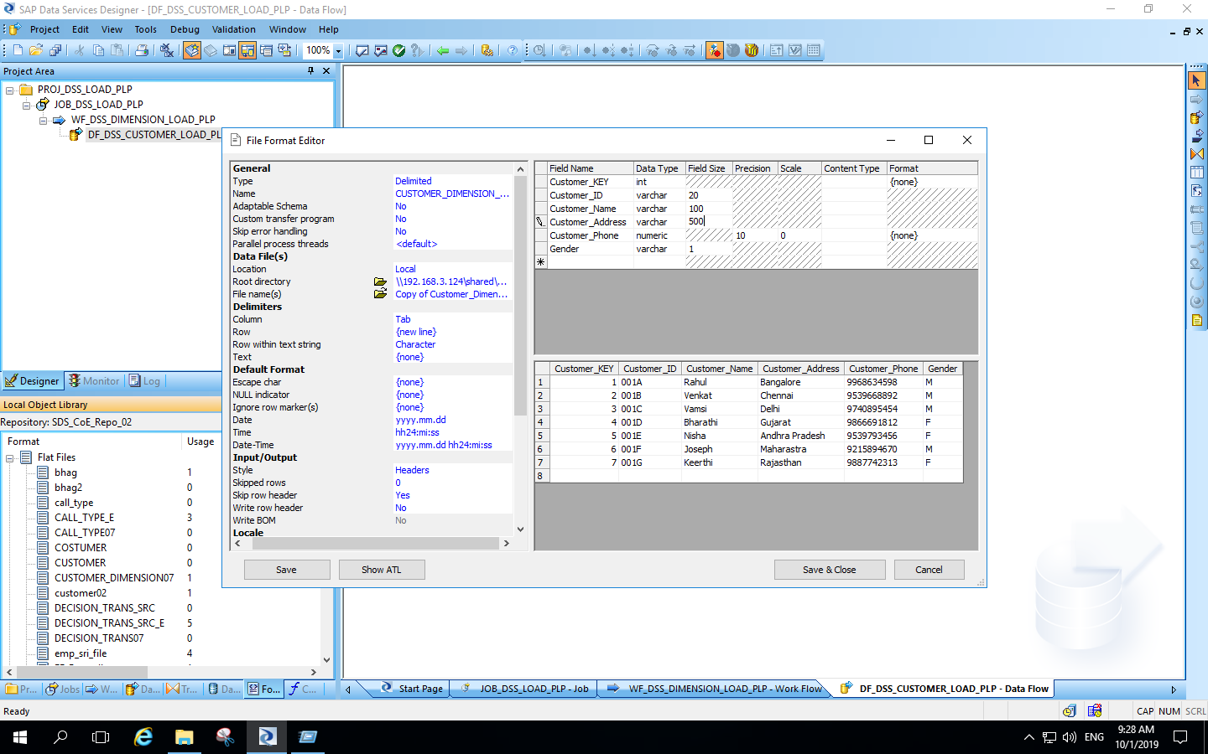
Creation of flat-file for customer dimension :

Slide 7
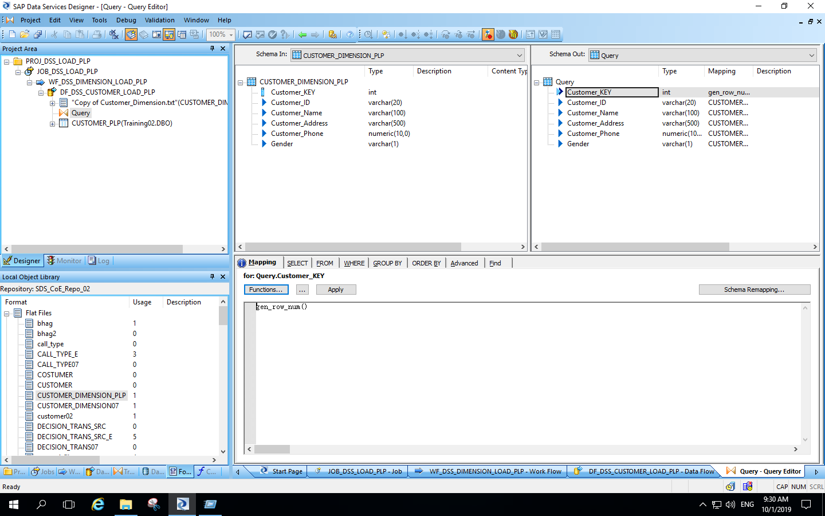
Query transformation for customer dimension :

Slide 8
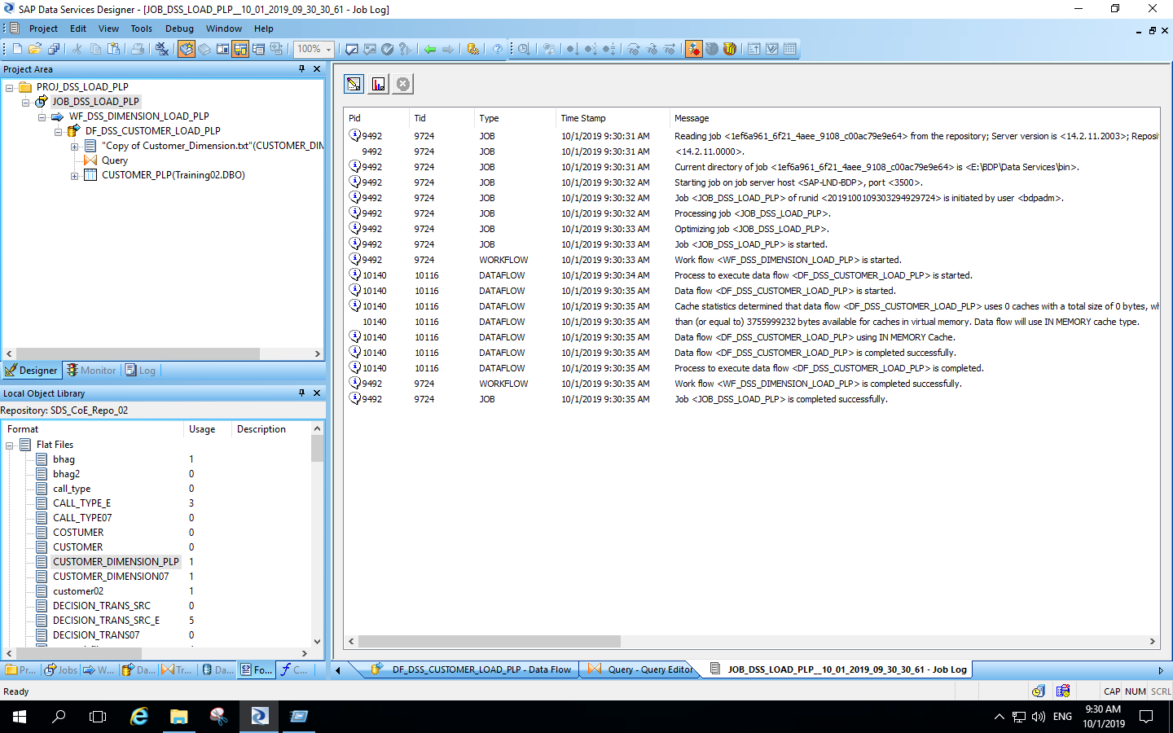
Execution of customer dimension data flow :

Slide 9
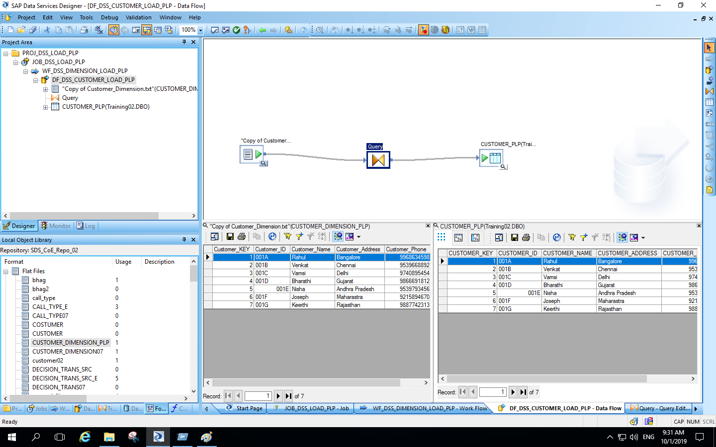
Output of customer dimension data flow :

Slide 10
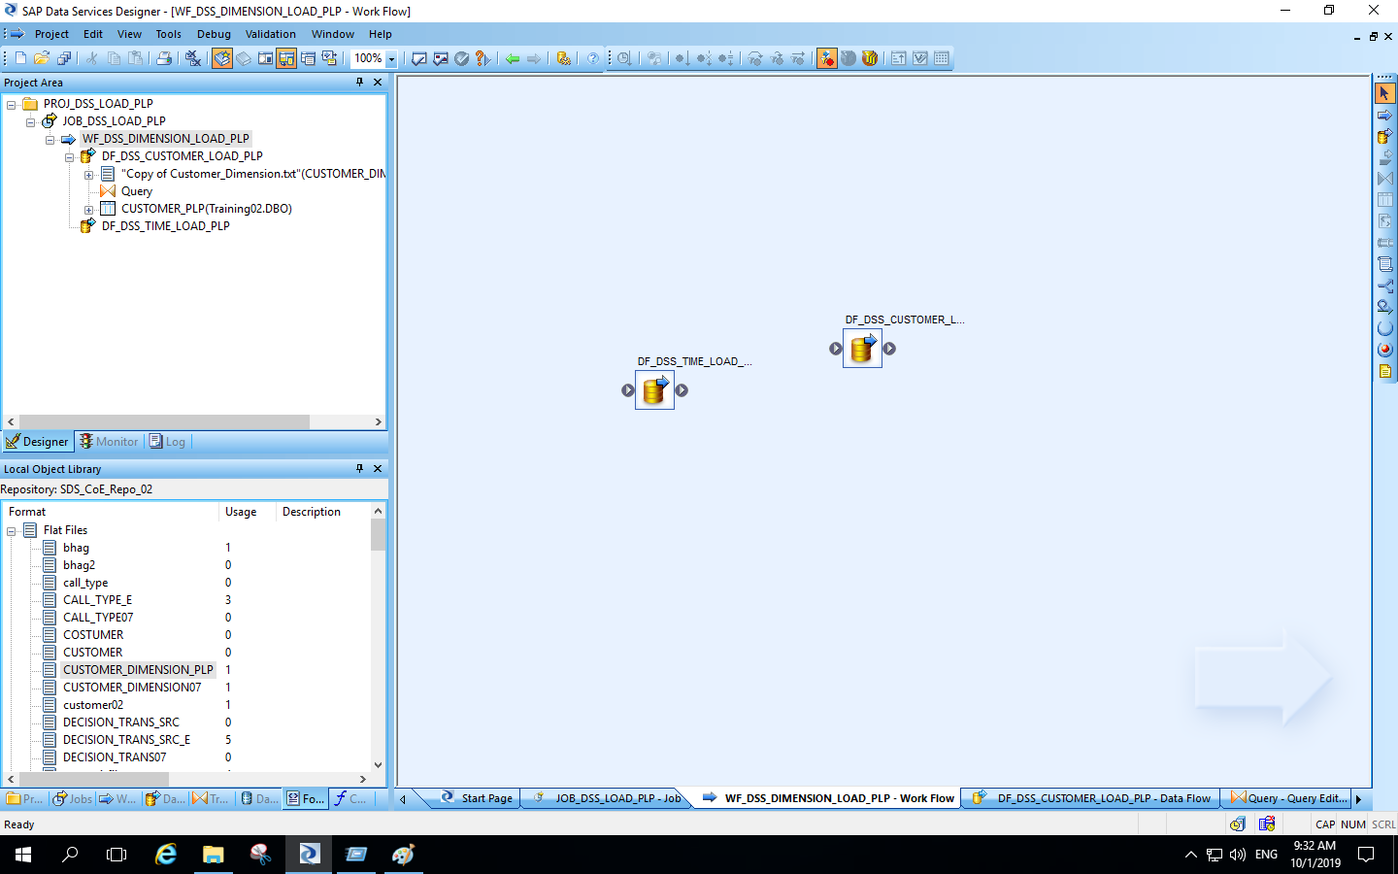
Data flow for time dimension :

Slide 11
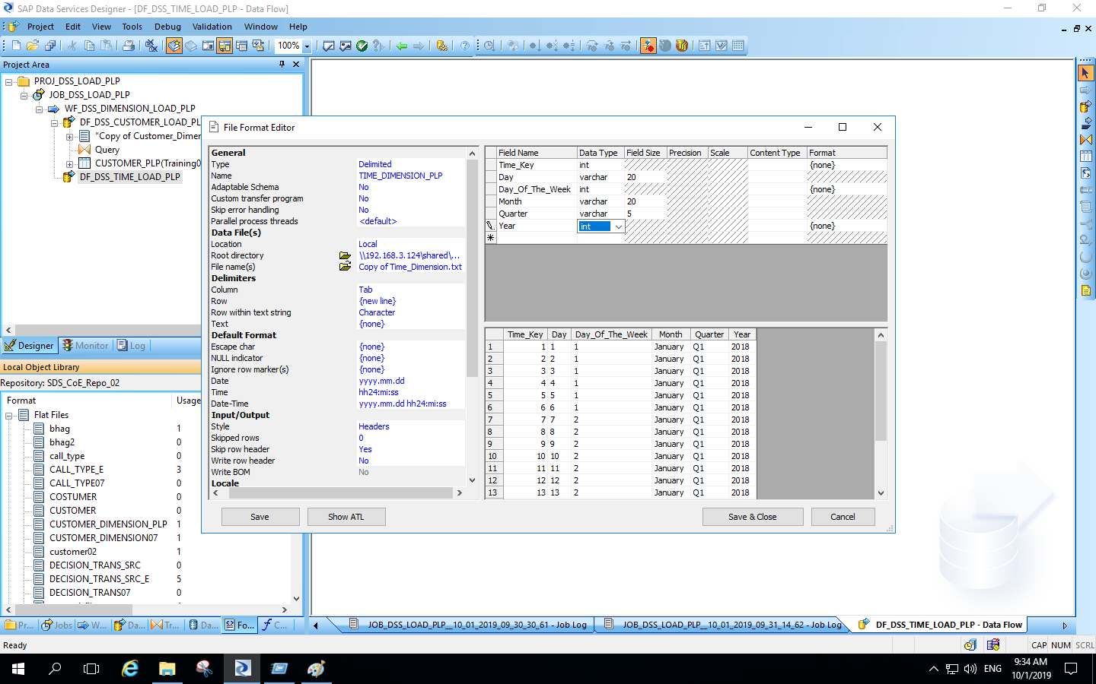
Flat file for time dimension :

Slide 12
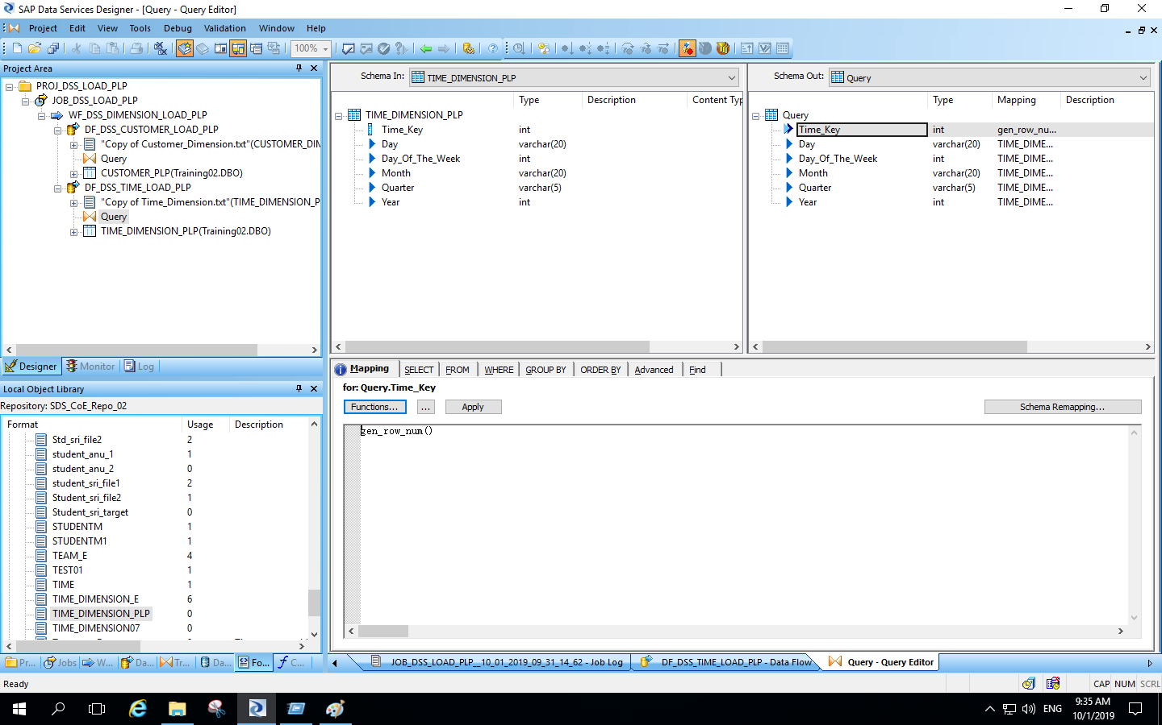
Query transformation for time dimension :

Slide 13
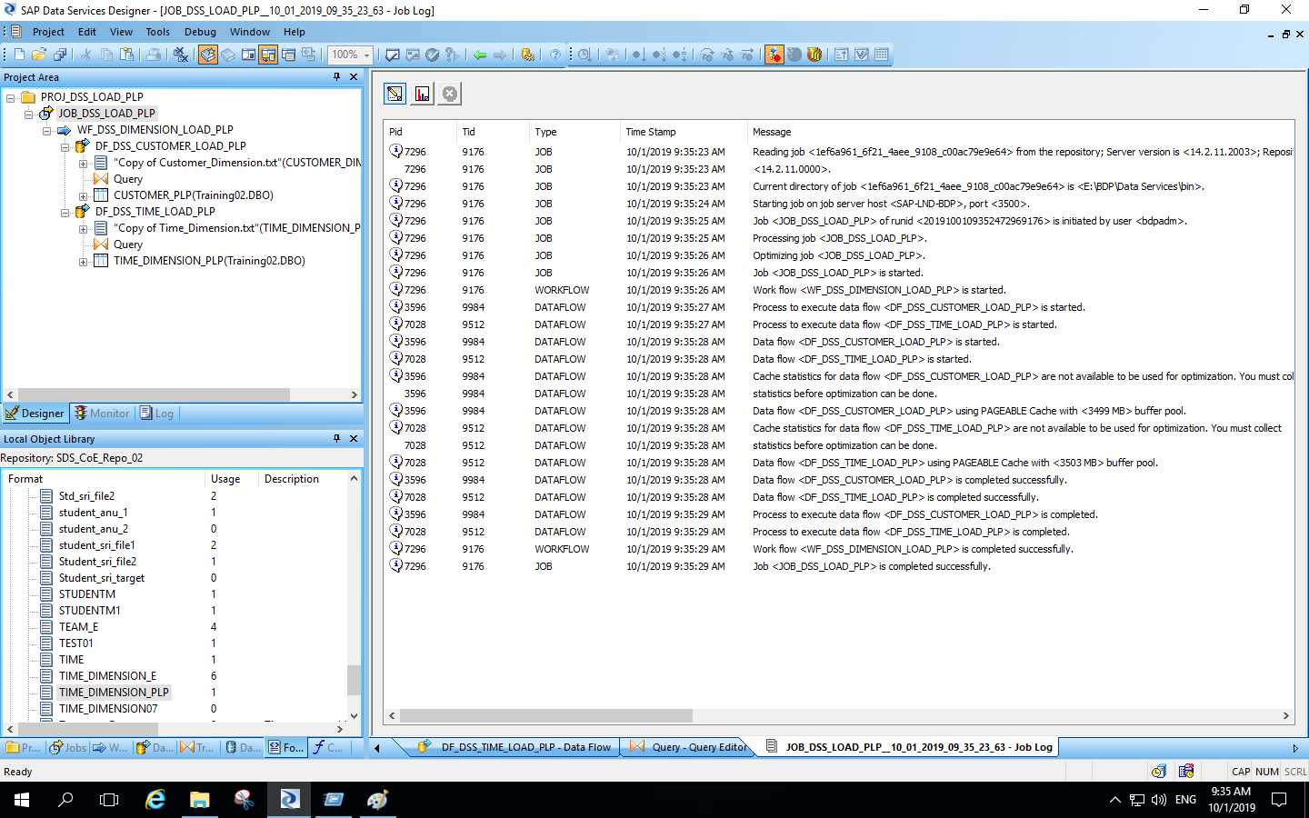
Execution of time dimension data flow :

Slide 14
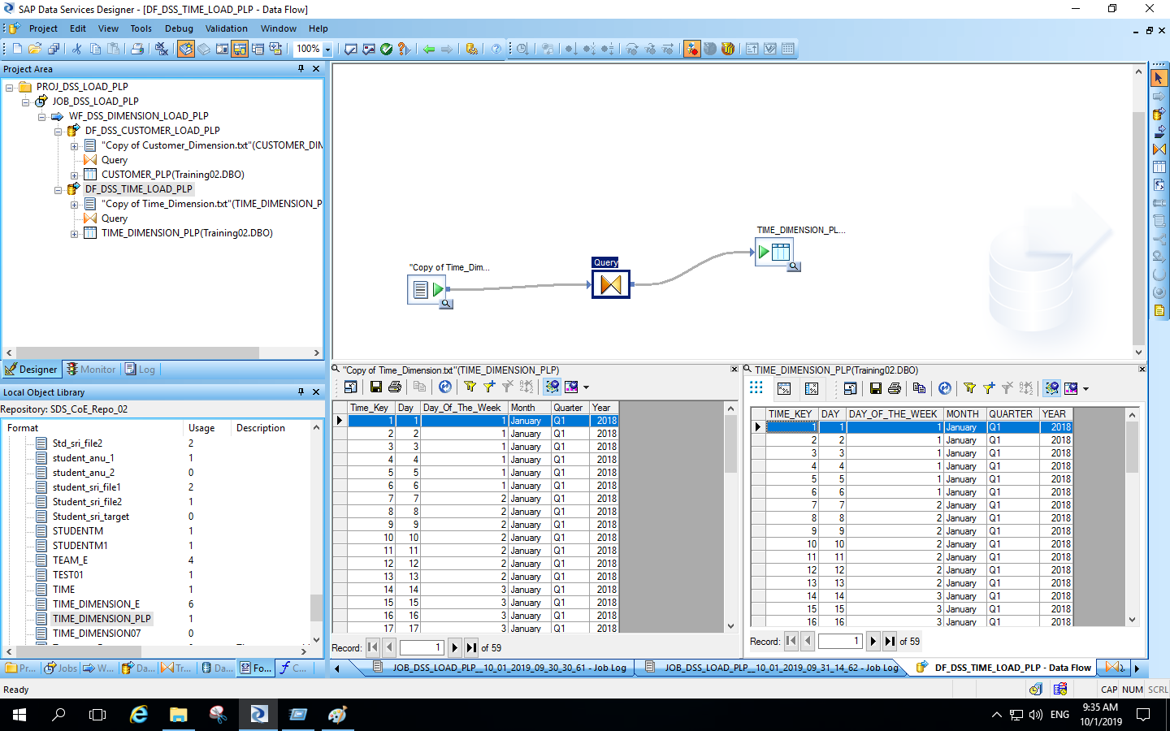
Output of time dimension data flow :

Slide 15
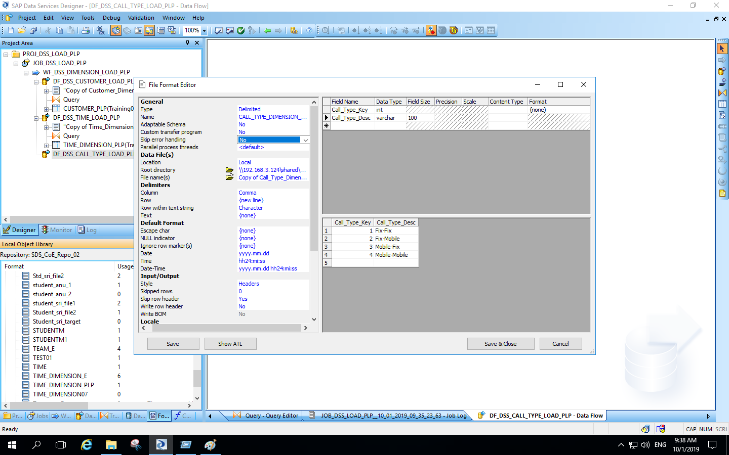
Creation of flat-file for call type dimension :

Slide 16
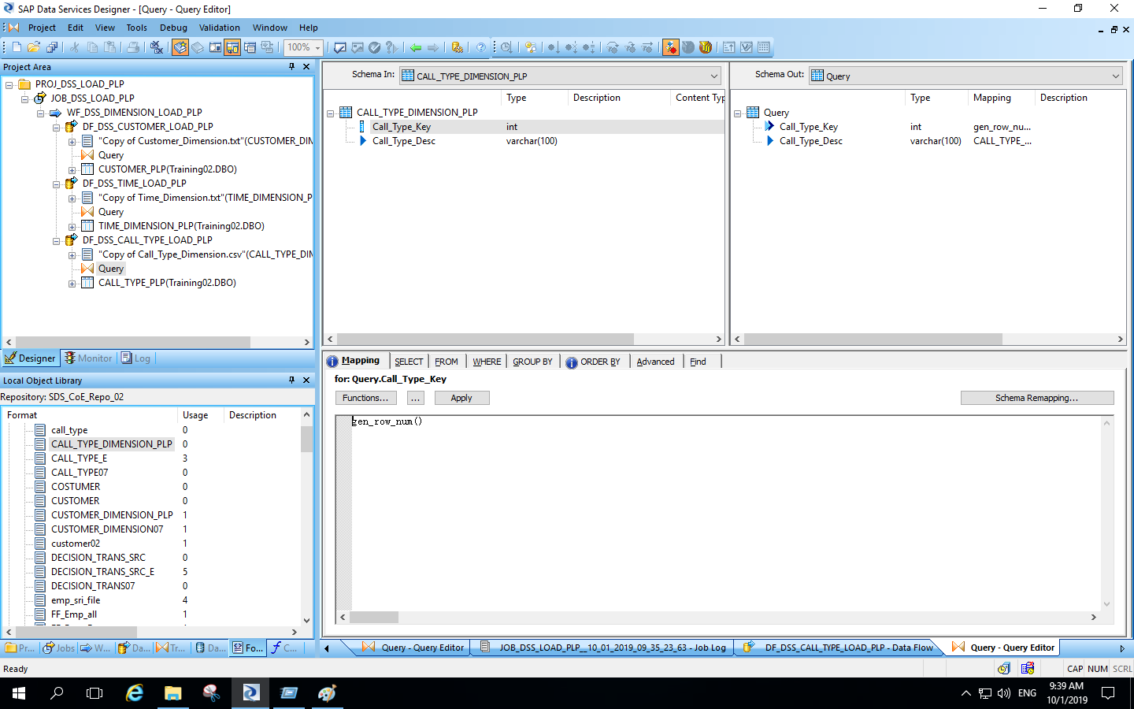
Query transformation for call type dimension :

Slide 17
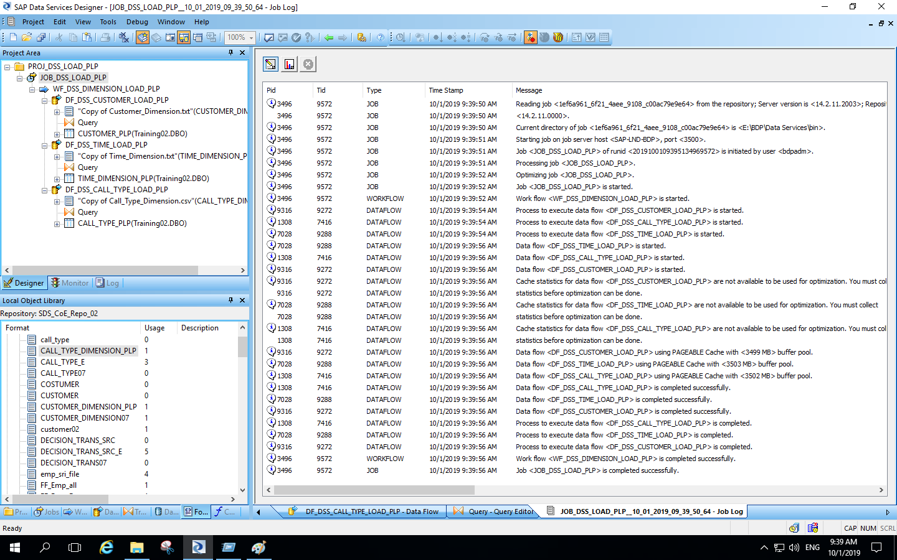
Execution of call type dimension data flow :

Slide 18
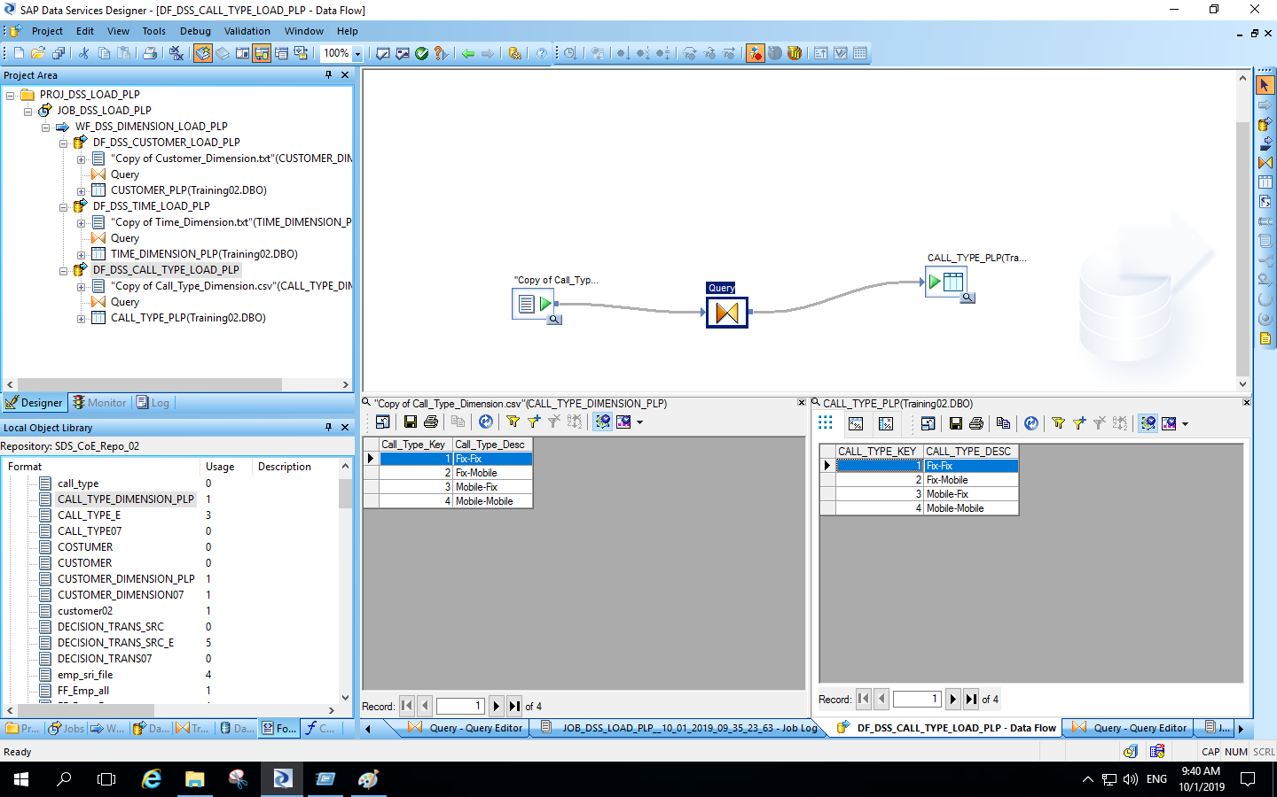
Output for call type dimension data flow :

Slide 19
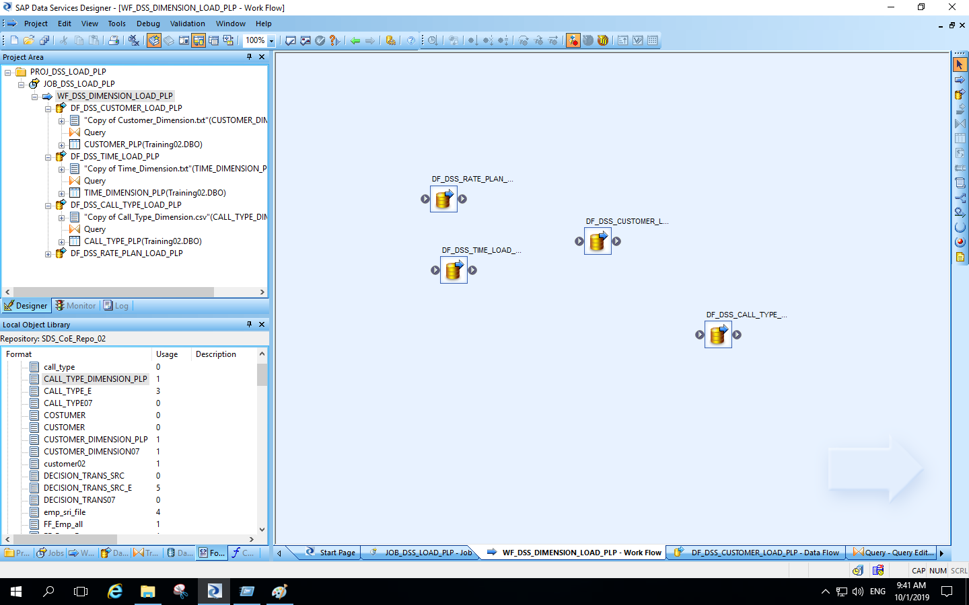
Creation of rate plan dimension data flow :

Slide 20
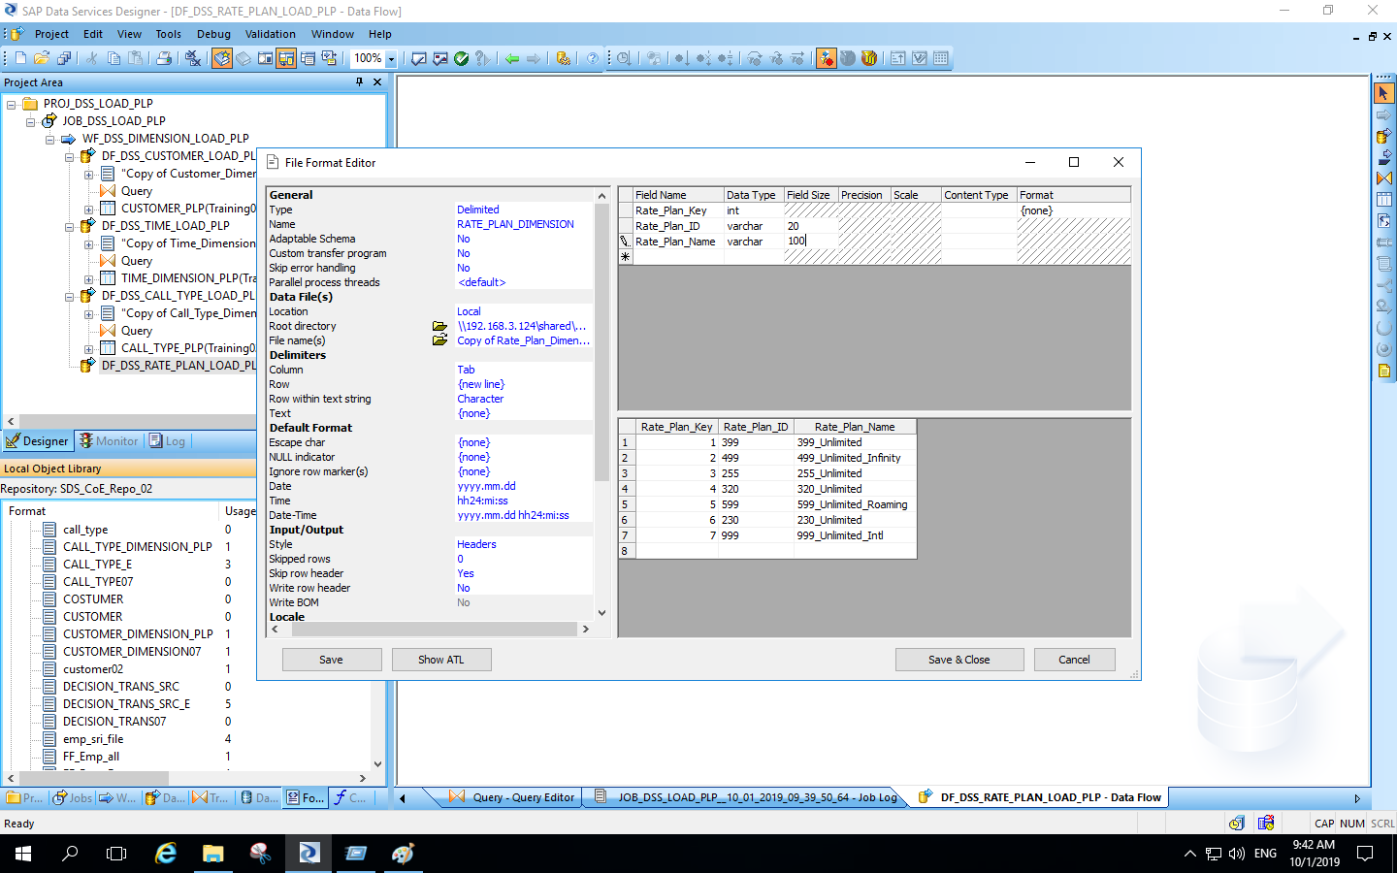
Creation of flat-file for rate plan dimension :

Slide 21
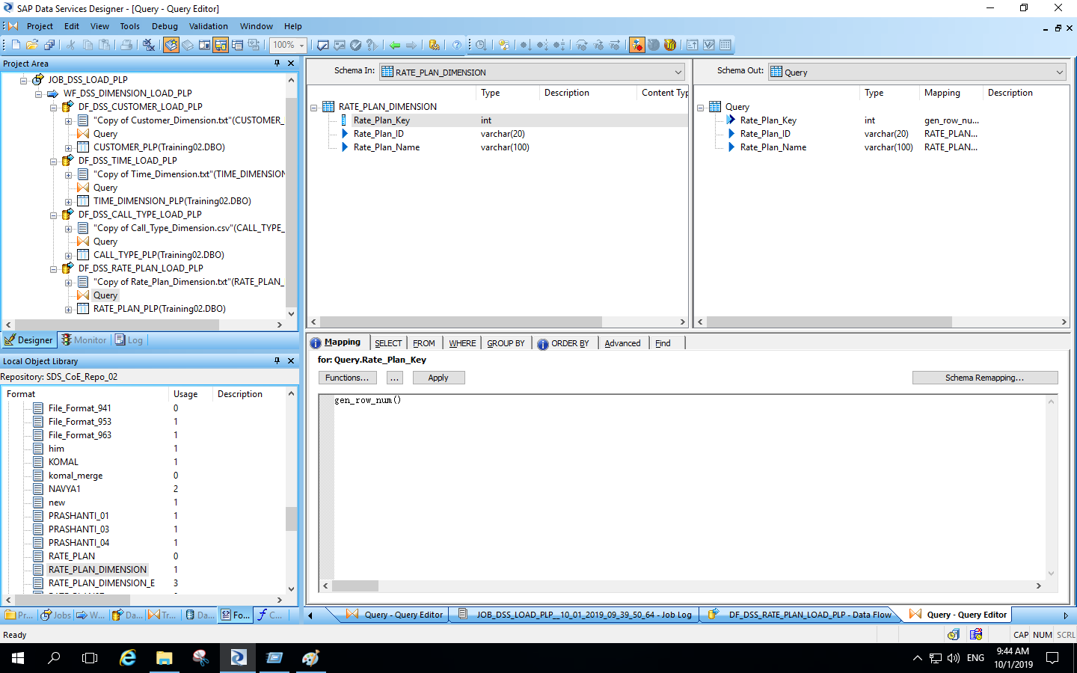
Query transformation for rate plan dimension :

Slide 22
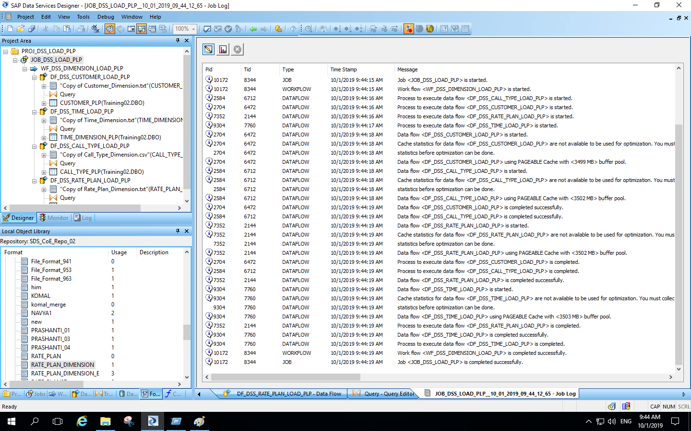
Execution of rate plan dimension data flow :

Slide 23
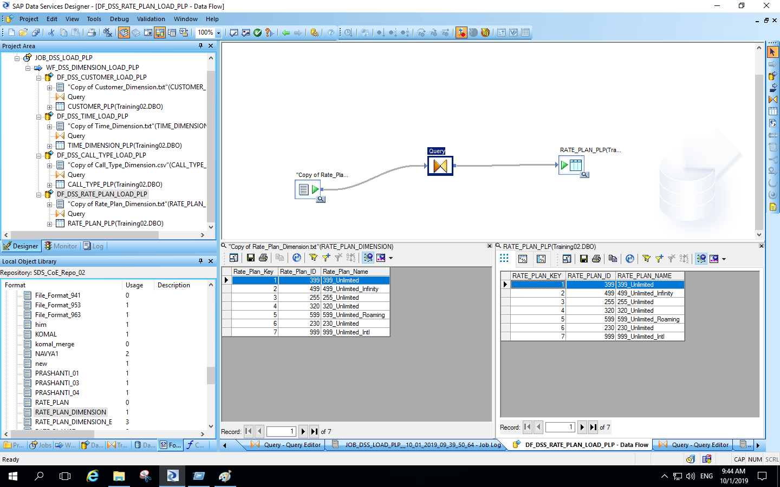
Output for rate plan dimension data flow :

Slide 24
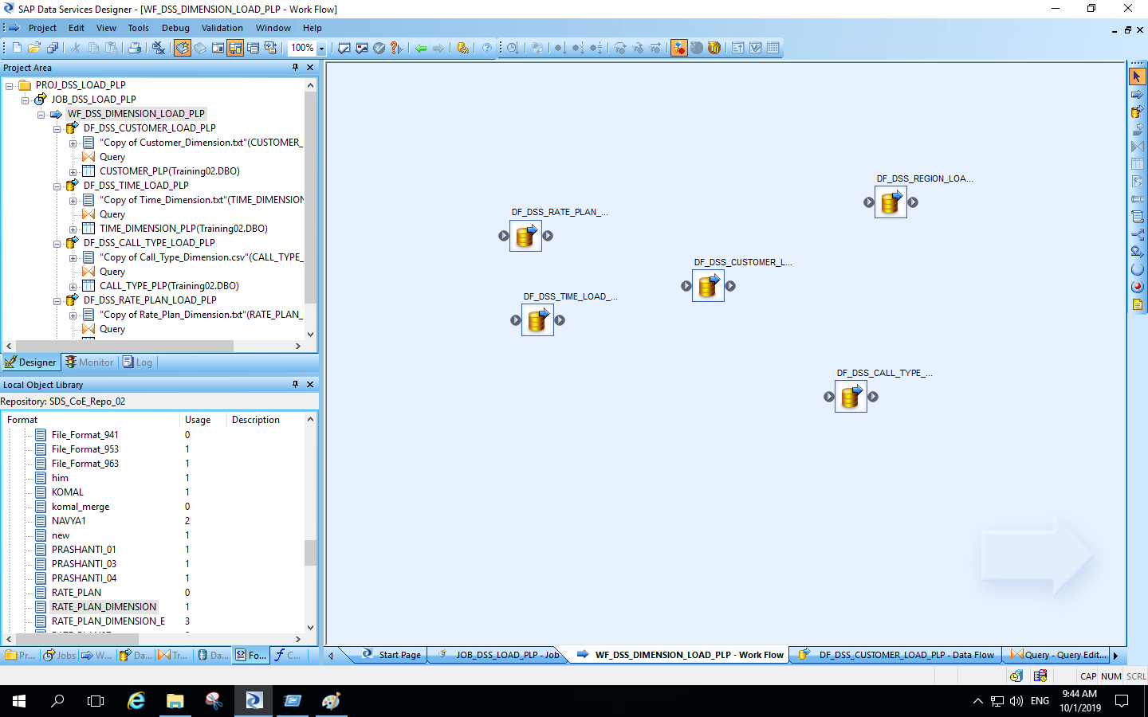
Creation of region dimension data flow :

Slide 25
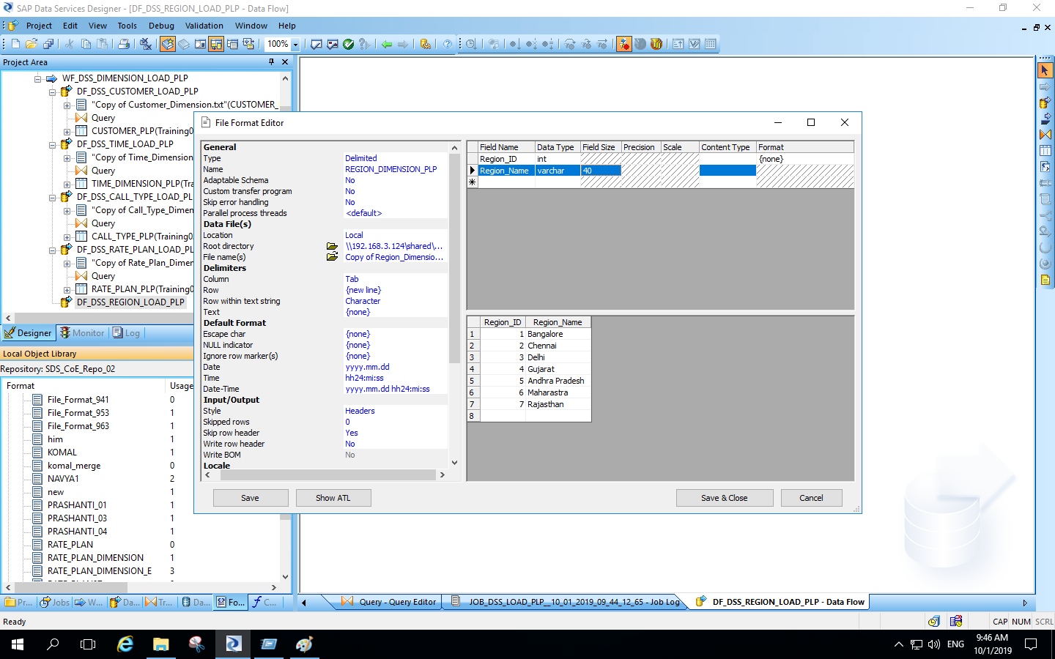
Creation of flat-file for region dimension :

Slide 26
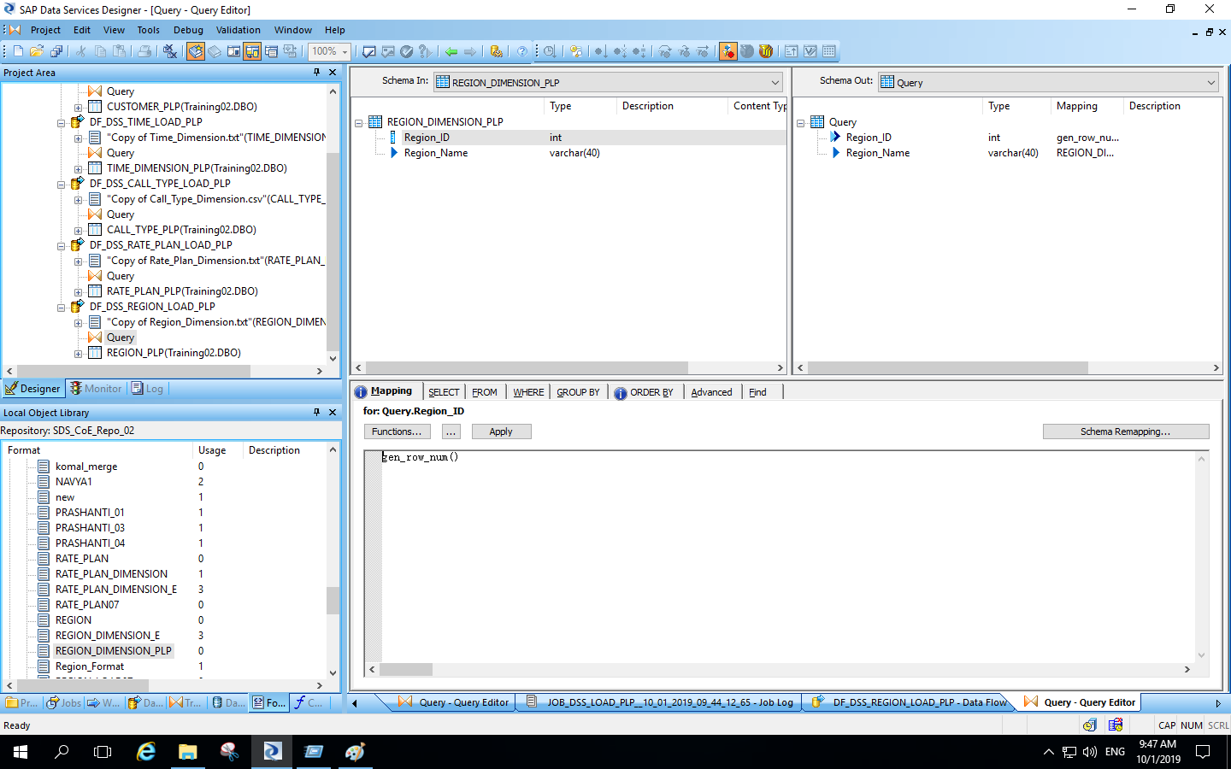
Query transformation for region dimension :

Slide 27
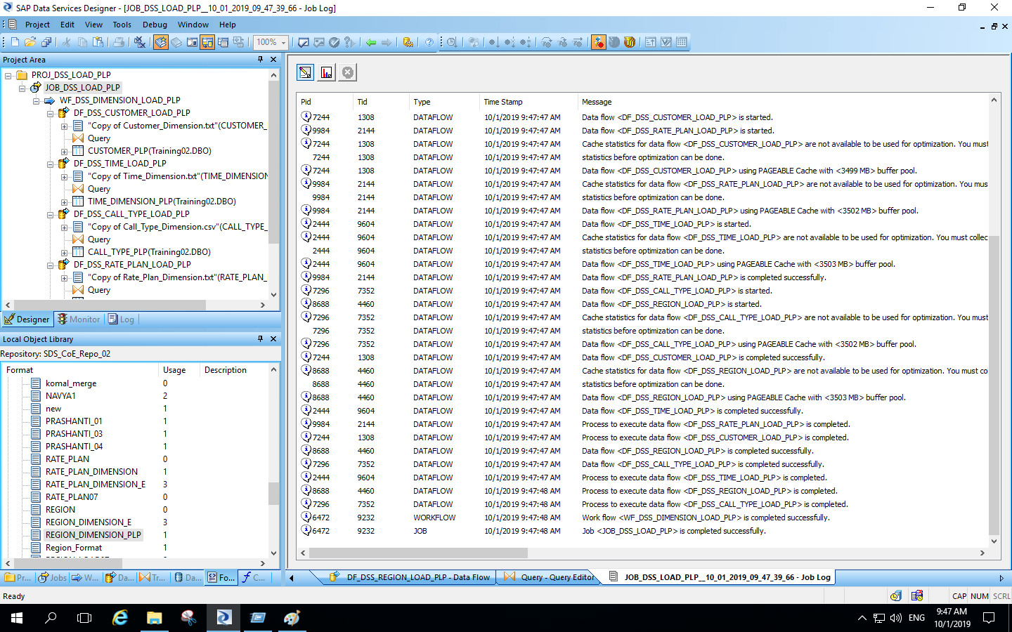
Execution of region dimension data flow :

Slide 28
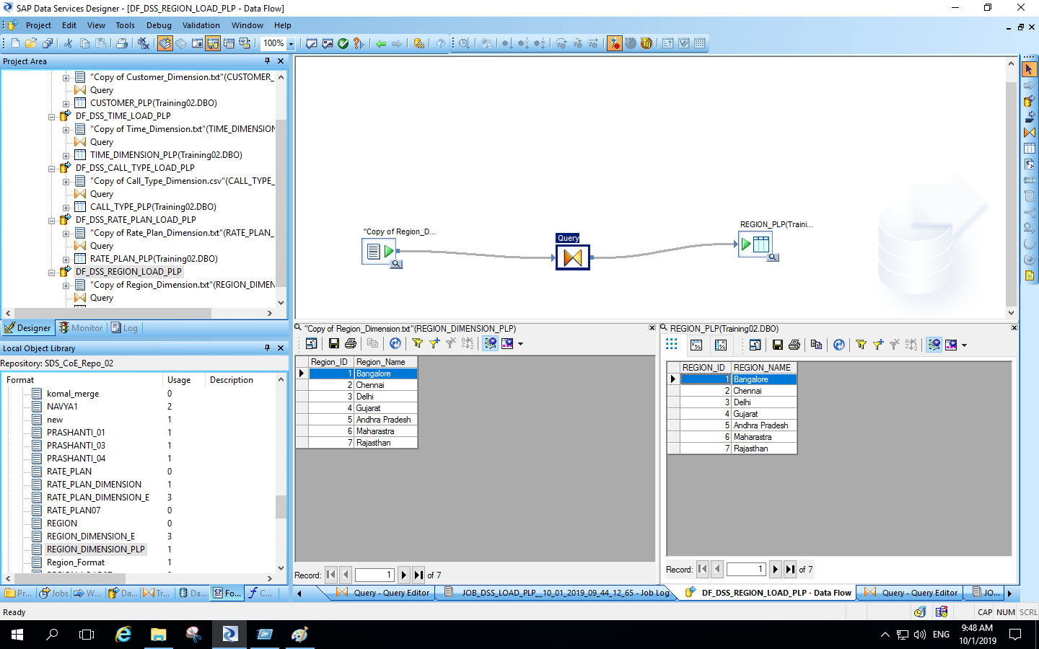
Output for region dimension data flow :

Slide 29
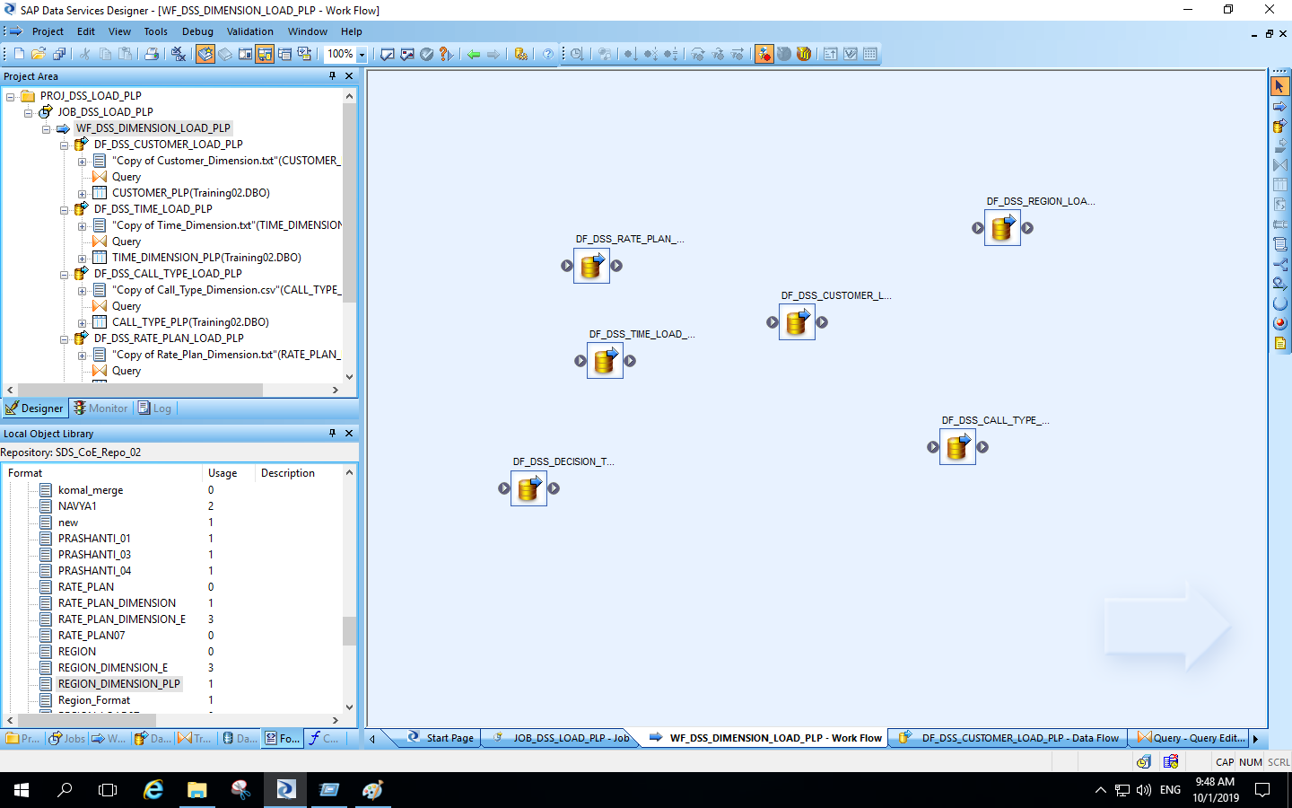
Creation of data flow for decision_trans_src :

Slide 30
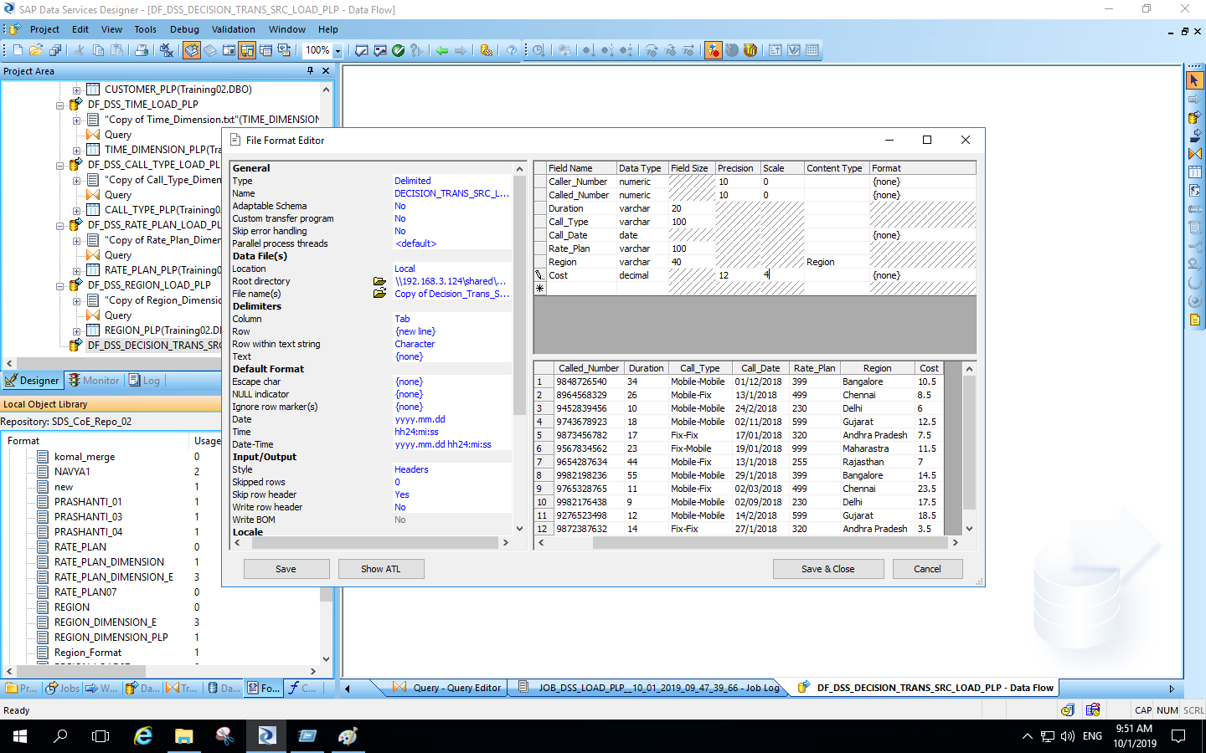
Creation of flat-file for decision_trans_src :

Slide 31
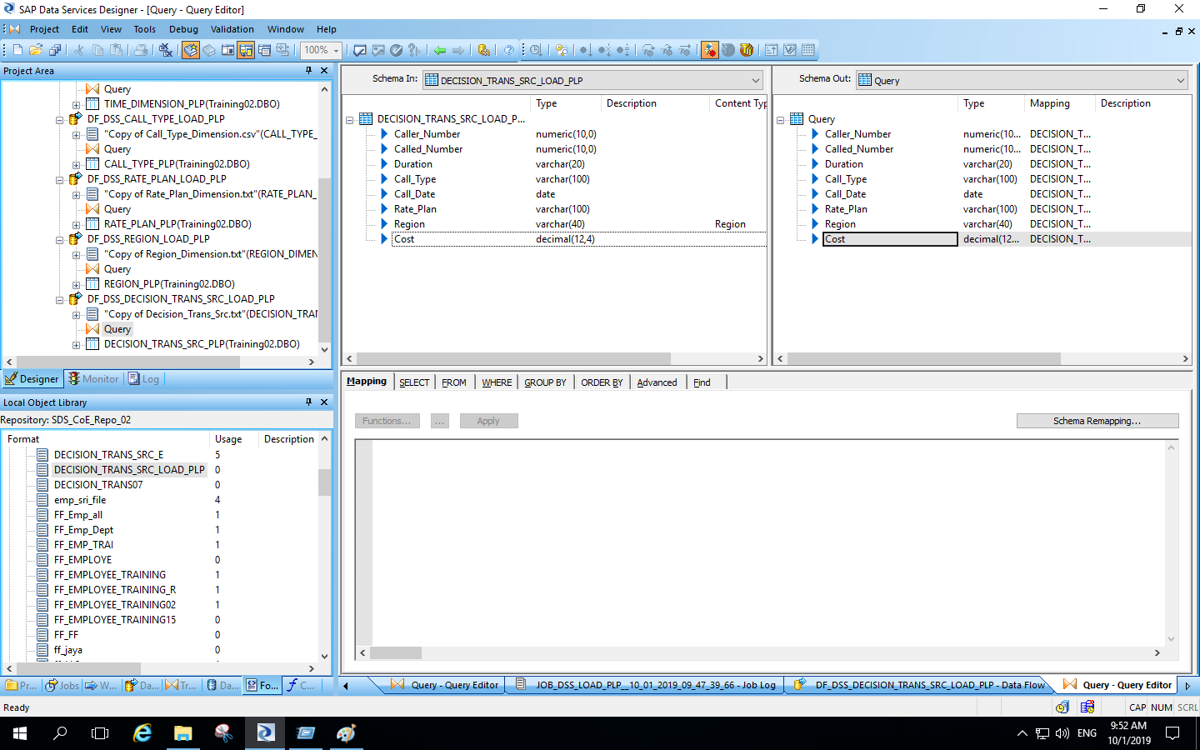
Query transformation for decision_trans_src dimension :

Slide 32
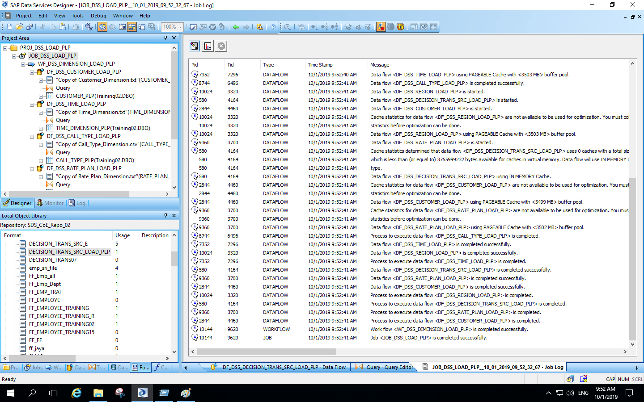
Execution of decision_trans_src data flow :

Slide 33
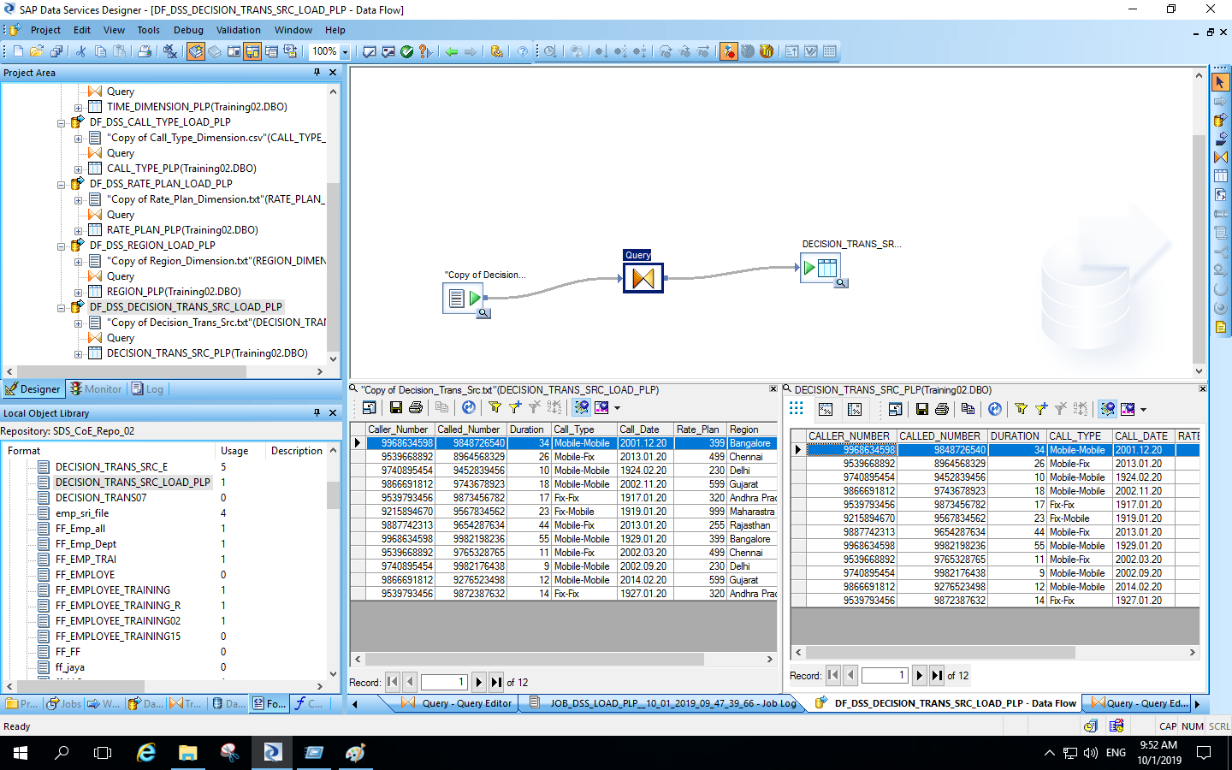
Output for decision_trans_src data flow :

Slide 34
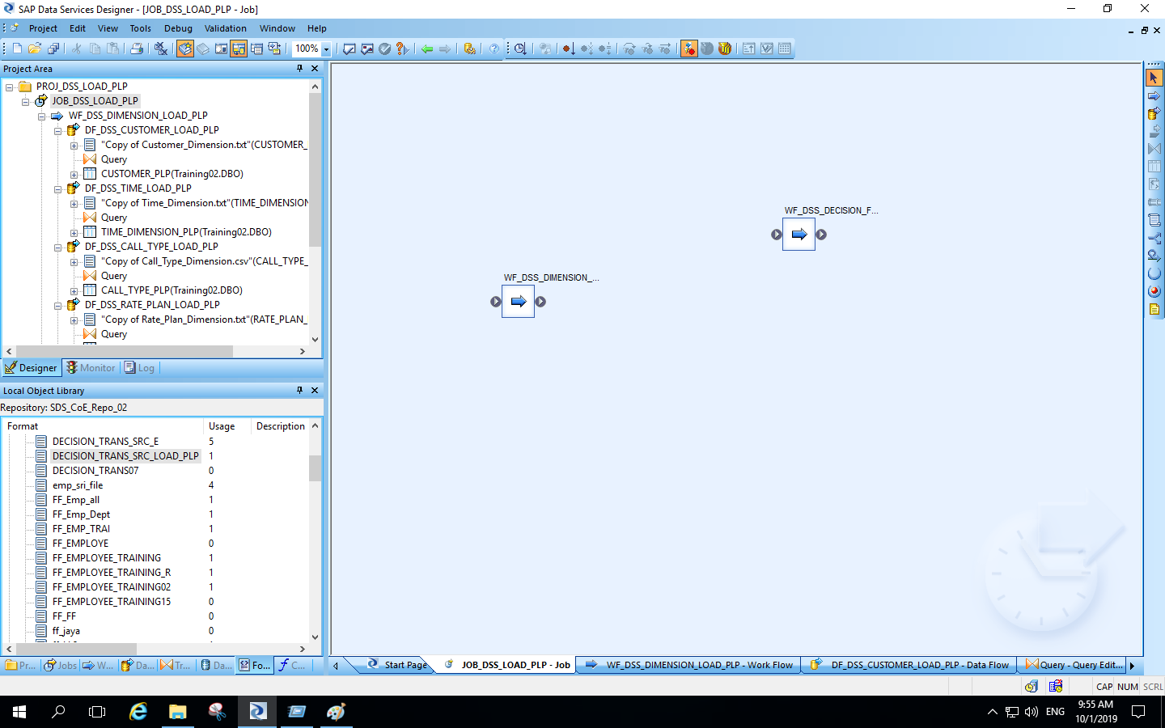
Creation of work flow for decision_fact_load :

Slide 35
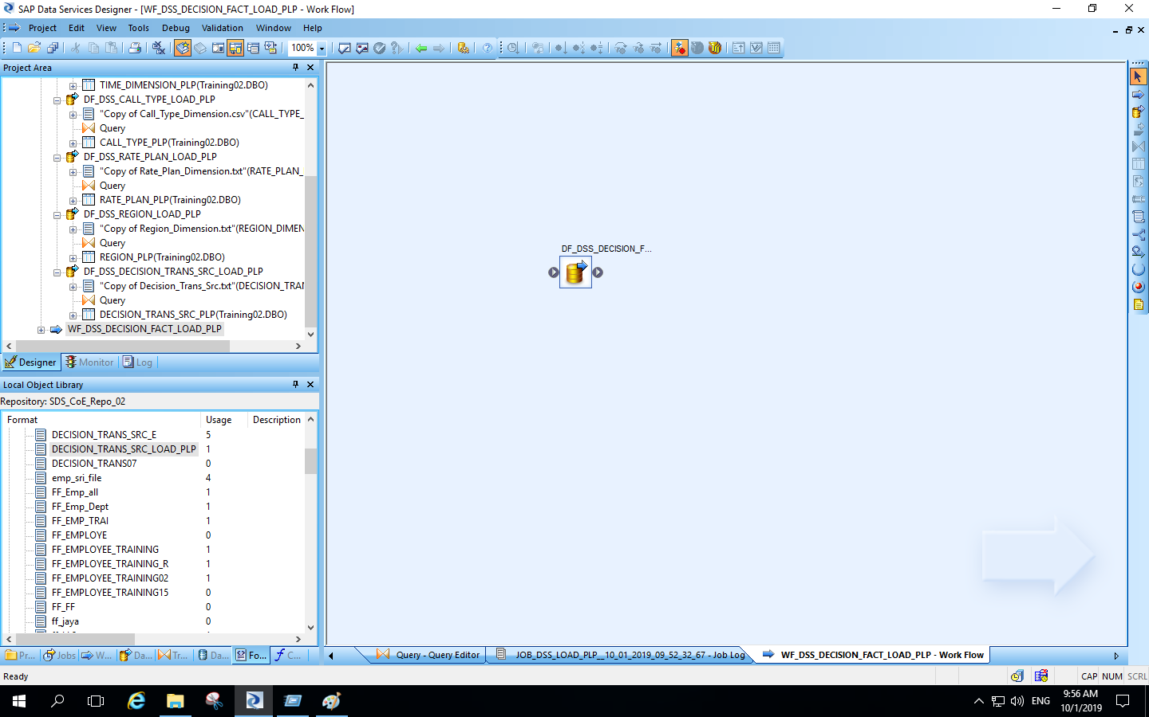
Creation of data flow for decision_fact_load :

Slide 36
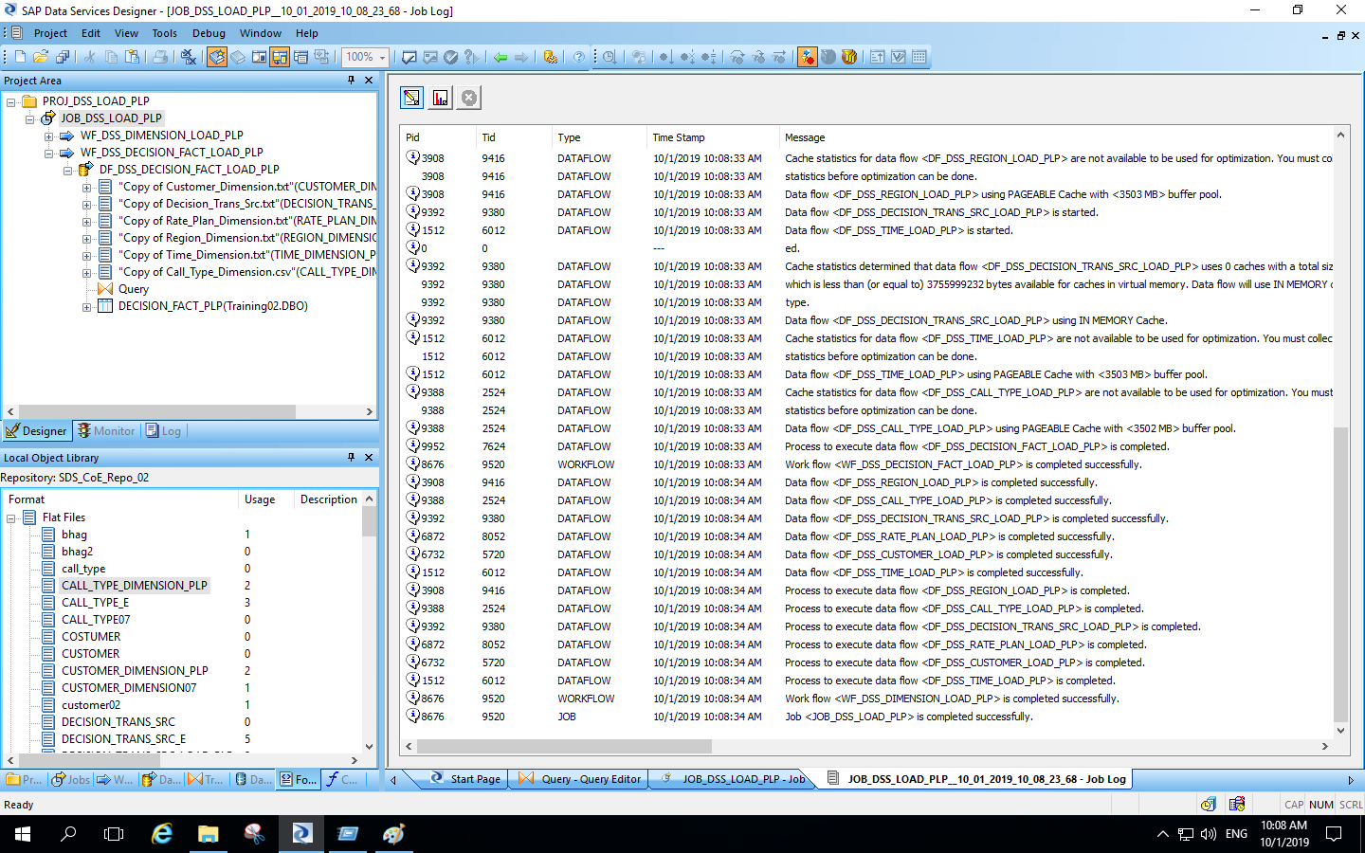
Execution of decision_fact_load data flow :

Slide 37
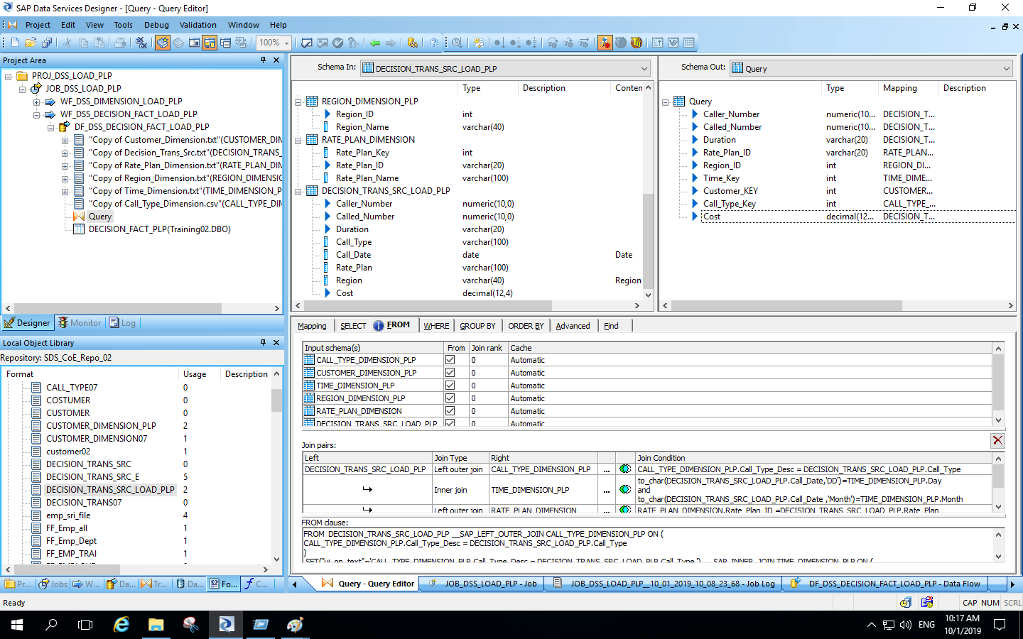
Query transformation for decision_fact_load :

Slide 38
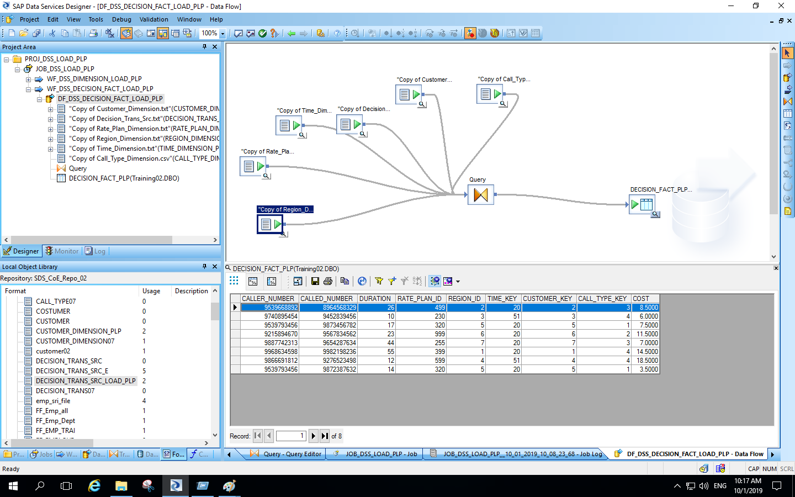
Output for decision_fact_load data flow :

